Slide 1
Analysis of Asset Class ETF Data
Tom Parkinson

Slide 2
Introduction
Tom Parkinson
Background
Analysis Performed
Key Findings
I sourced Exchange Traded Fund (ETF) data from ETFdb
The data covered ETFs in five asset classes: Alternatives, Bonds, Commodities, Equity & Multi-Asset
On 1 Year Performance Data
Data cleanup and standardization to ensure consistency across files
Calculated columns to help inform the analysis
Merging datasets, including ensuring column completeness
Correlation analysis, to spot trends in the data
Data visualisation
Performance Buckets: 5 – 10% 1-year returns most frequent
Performance over time: difficulties in sustaining excess performance over time
Performance vs size: small inverse relationship between size and 1-year performance

Slide 3
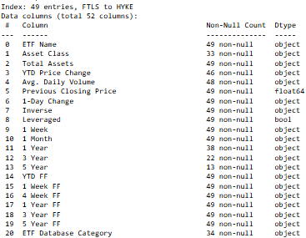
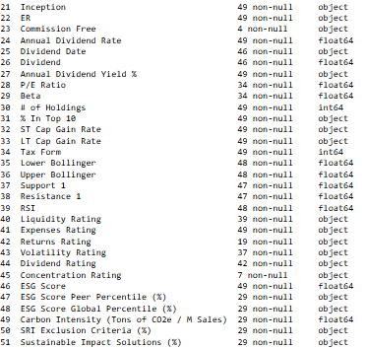
Analysis of Asset Class ETF Data – Data Clean up
Tom Parkinson
Importing the data into Jupyter Notebooks and understanding what is contained in the dataset
Understanding what is contained in the dataset [.info()]

Slide 4
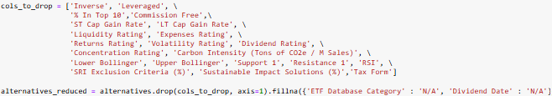
Analysis of Asset Class ETF Data – Data Clean up
Tom Parkinson
Identifying and fixing missing asset class names
display(alternatives[alternatives['Asset Class'].isnull()])
alternatives[['Asset Class']] = alternatives[['Asset Class']].fillna('Alternatives’)
Dropping non-useful columns and fixing remaining missing values

Slide 5
Analysis of Asset Class ETF Data – Data Clean up
Tom Parkinson
Removing special characters
alternatives_reduced = alternatives_reduced.replace({'%':'', ',':''}, regex=True)
Updating column names
alternatives_reduced = alternatives_reduced.rename({'YTD Price Change' : 'YTD Price Change %', '1-Day Change' : '1-Day Change %', '1 Week' : '1 Week Change %', '1 Month' : '1 Month Change %', '1 Year' : '1 Year Change %', '3 Year' : '3 Year Change %', '5 Year' : '5 Year Change %'}, axis = 1)
Converting numeric columns to floats and integers

Slide 6

Analysis of Asset Class ETF Data – Calculations
Tom Parkinson
Calculating the 1-Day, 1-Week etc prices from the % Change

Slide 7
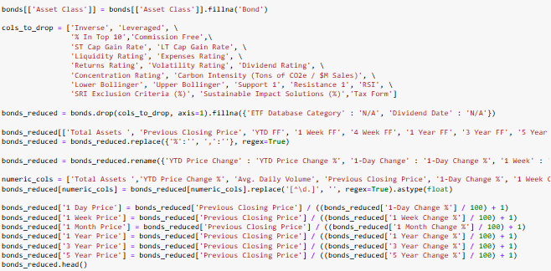
Analysis of Asset Class ETF Data – Dataset Merging
Tom Parkinson
Repeating the code for the alternatives dataset for the other x4 asset classes (note for discussion how to create a user-defined function where python can take the file name and run the below code)

Slide 8
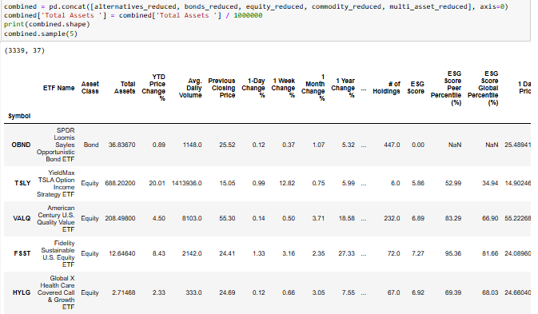
Analysis of Asset Class ETF Data – Dataset Merging
Tom Parkinson
Cleaned datasets merged using .concat() given the column names are consistent across all

Slide 9

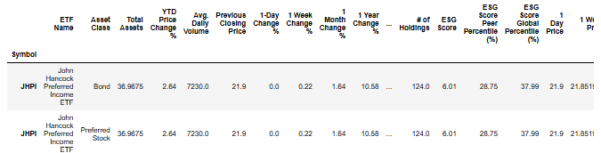

Analysis of Asset Class ETF Data – Dataset Merging
Tom Parkinson
Review for ETF fund name duplicates and removal from the combined dataset
John Hancock Preferred Income ETF identified as a true duplicate (same Symbol) and removed from the dataset

Slide 10
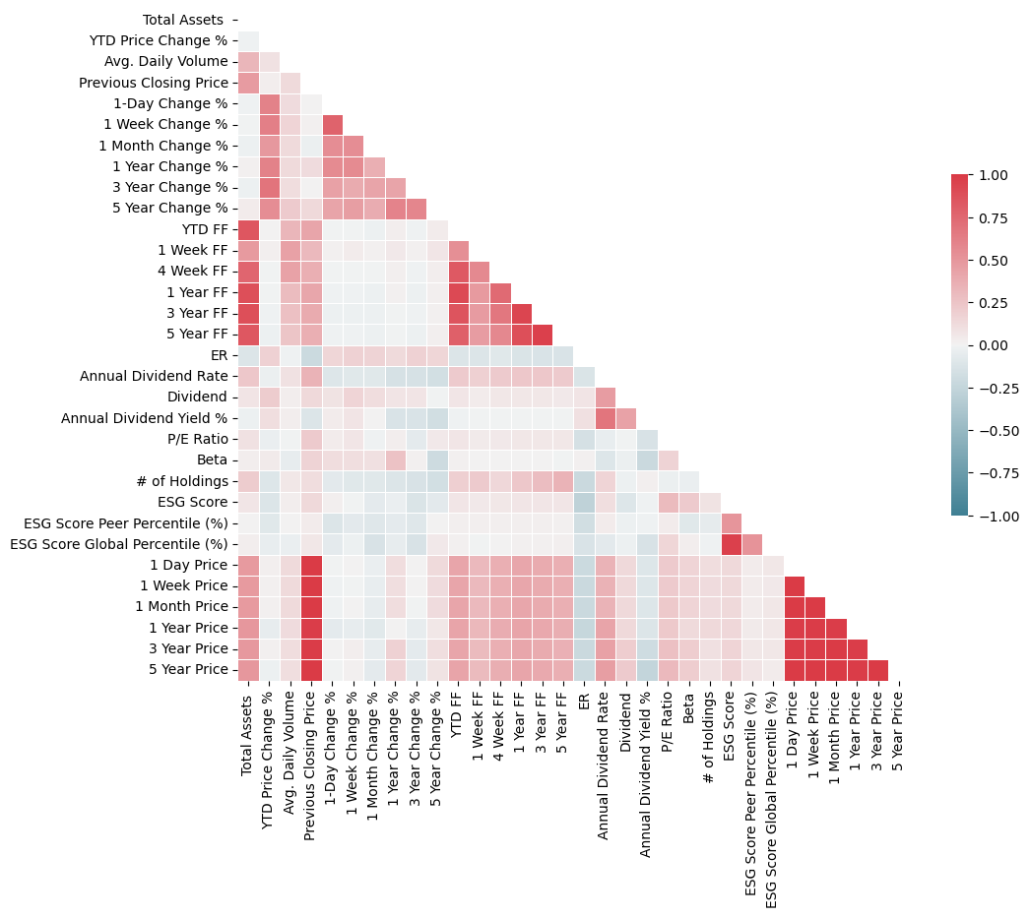
Analysis of Asset Class ETF Data – Correlation Analysis
Tom Parkinson
Creating a correlation matrix for all numerical columns by relative strength

Slide 11
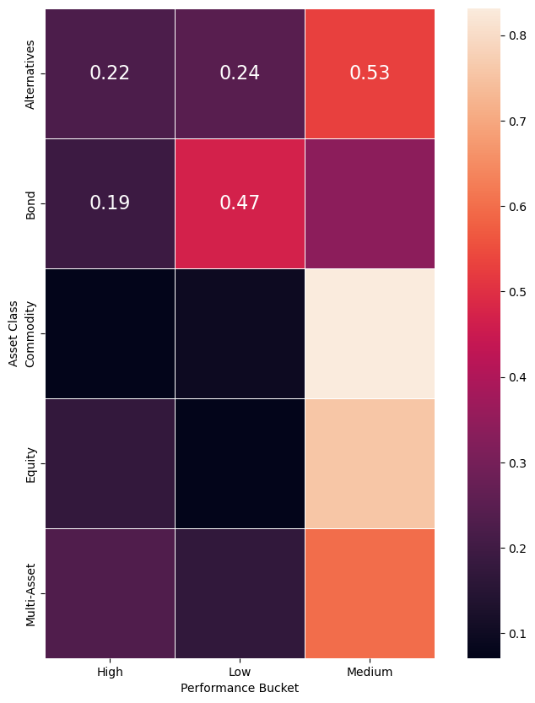
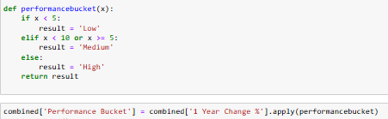
Analysis of Asset Class ETF Data – Data Visualisation
Tom Parkinson
Creating High, Medium and Low 1 year performance buckets to see how the asset classes perform. How do you edit the graph so the columns go High, Medium and the Low?

Slide 12
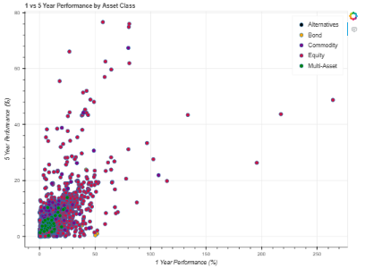
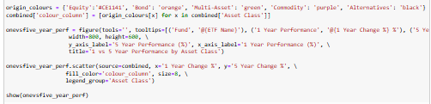
Analysis of Asset Class ETF Data – Data Visualisation
Tom Parkinson
1 vs 5 year performance by Asset Class with tooltips

Slide 13
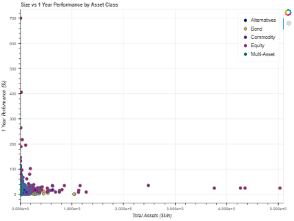
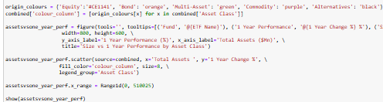
Analysis of Asset Class ETF Data – Data Visualisation
Tom Parkinson
1 year vs size performance by Asset Class with tooltips

Slide 14
Analysis of Asset Class ETF Data – Initial Findings and Next Steps
Tom Parkinson
Initial Findings:
Correlation: strong correlation of price data across all time periods as well fund flow with total assets
Performance Buckets: across asset classes a consistent theme of Medium (5 <= x < 10) 1-year performance being the most concentrated. Commodities and Equities almost no low performers
Performance over time: clearly demonstrates the difficulty in sustaining excess performance over time e.g. max 1 year return over 250% but only 80% for 5 years
Performance vs size: there seems to be a small inverse relationship between size and 1-year performance, likely explained by larger firms affecting market prices and thereby unable to generate excess returns
Follow ups to enhance analysis:
Source Daily Fund Price Data: in order to calculate portfolio variance and therefore to understand the relative risk/reward profile
Create efficient portfolio: with the variance data a Markowitz efficient portfolio can be created to determine the optimal portfolio for believers in the efficient markets hypothesis
Function to automate cleanup for any amount of files: assuming the file format is consistent a function that can pick up all uploaded files and run the data cleanup based on the file name
Additional Asset Classes: e.g. Real estate, currency etc

